Slide 1
Welcome to EcoCharge
~Power your devices. Protect your planet.

Slide 2
Overview of EcoCharge
EcoCharge is revolutionizing portable power solutions with cutting-edge solar-powered technology. Designed for modern lifestyles, EcoCharge combines convenience, reliability, and sustainability to meet the growing need for eco-friendly energy on the go.
Our Mission
Redefining portable charging with sustainable innovation.At EcoCharge, we are committed to empowering individuals with clean, renewable energy solutions. By blending advanced solar technology with user-friendly design, we aim to create a future where staying connected no longer comes at the cost of the environment.

Slide 3
The Problem
Limited Access to Power in Remote Areas: Traditional chargers depend on electrical outlets, leaving users stranded without power
during outdoor activities, travel, or emergencies.
Inconvenience of Frequent Recharging: Most portable chargers require regular recharging themselves, adding an extra layer of hassle
for users.
Environmental Impact of Traditional Charging: Conventional charging methods rely heavily on non-renewable energy, contributing to
increased carbon emissions and environmental harm.
Dependence on Single-Purpose Devices: Regular power banks lack adaptability and functionality, offering no innovative features to
cater to modern, sustainable lifestyles.
Growing Energy Needs of Modern Consumers: With people carrying multiple devices like phones, tablets, and cameras, the demand for
reliable charging solutions has surpassed the capabilities of traditional chargers.
Increased Demand for Eco-Friendly, Smart Solutions: Today’s consumers are actively seeking sustainable, multi-functional, and innovative energy
solutions that align with their on-the-go lifestyles and environmental values.

Slide 4

The Solution: EcoCharge
Solar-Powered Charging Anywhere: EcoCharge uses renewable solar energy to provide clean, reliable power on the go, eliminating the need for electrical outlets and reducing your carbon footprint.
Lightweight, Durable, and Convenient: Designed for outdoor and everyday use, EcoCharge combines a portable, rugged design with fast and efficient charging capabilities, ensuring your devices are always powered.
Universal Compatibility and Sustainability: Works with a wide range of devices while promoting eco-conscious living through sustainable energy solutions.

Slide 5
Market Opportunity: EcoCharge
Global Portable Power Market: The global portable charger market is projected to grow significantly, driven by the increasing reliance on mobile devices and the demand for renewable energy solutions.
Market Size: Valued at $10 billion+ and growing annually.
Trend: Rising consumer preference for eco-friendly and sustainable charging options.
Target Market Segments:
Outdoor Enthusiasts:
Campers, hikers, and adventurers seeking reliable power sources in remote locations.
Need: A portable, solar-powered charger that works off-grid.
Eco-Conscious Consumers:
Individuals actively reducing their carbon footprint by choosing sustainable products.
Need: A renewable, environmentally-friendly charging solution.
Travelers and Commuters:
Frequent travelers and daily commuters needing power on the go.
Need: Lightweight, portable, and efficient charging options.

Slide 6
Business Model: EcoCharge
Revenue Streams:
Direct-to-Consumer Sales:
Online sales through our website and e-commerce platforms like Amazon.
Focus on targeting eco-conscious consumers, outdoor enthusiasts, and travelers.
Retail Partnerships:
Collaborations with outdoor gear retailers, electronic stores, and sustainable product chains.
Expand reach through in-store displays and partnerships with established retail brands.
Licensing Technology:
Licensing our proprietary solar charging technology to other companies in related industries, such as outdoor equipment manufacturers or renewable energy solutions.

Slide 7
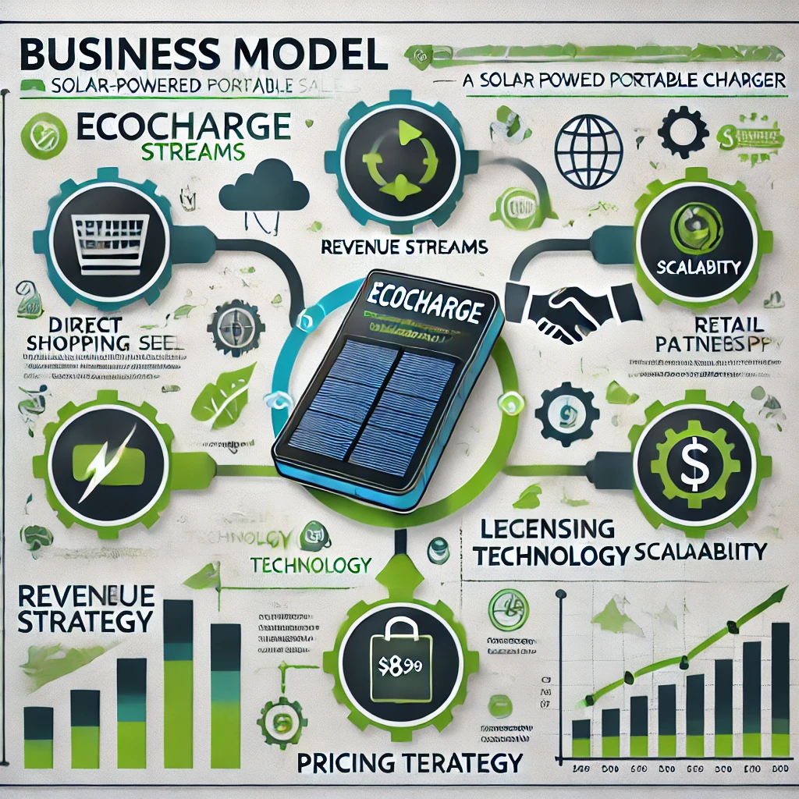
Pricing Strategy:
Premium Yet Competitive:
Positioned as a high-quality, durable, and eco-friendly product, priced competitively to attract early adopters and environmentally conscious buyers.
Example Pricing: $89.99 per unit, offering excellent value compared to traditional chargers.
Focus:
EcoCharge’s business model emphasizes scalability through diverse revenue streams while maintaining affordability and aligning with sustainability values.

Slide 8
Marketing & Growth Strategy
3. Expansion Plans
International Markets:
Launch EcoCharge in countries with high adoption of sustainable products (e.g., USA, Canada, Germany, Australia).
Tailor marketing strategies to fit local markets and emphasize regional environmental benefits.
Diverse Product Lines:
Expand into related product categories, such as solar-powered backpacks or multi-device charging hubs.
Develop limited-edition products for niche markets (e.g., rugged outdoor versions or premium luxury models).
. Branding and Positioning
Message: Position EcoCharge as a perfect blend of luxury and practicality.
Luxury: Sleek, modern design and advanced solar technology.
Practicality: Reliable and eco-friendly charging for everyday and outdoor use.
Tagline: "Power meets sustainability."
Emphasize the dual value of sustainability and high-performance technology in all marketing materials.
2. Digital Marketing
Social Media Campaigns:
Use Instagram, Facebook, and TikTok to highlight EcoCharge’s eco-friendly features, portability, and convenience.
Share user-generated content, real-life testimonials, and outdoor use cases.
Run contests with hashtags like #EcoChargeAnywhere or #SustainablePower.
Influencer Collaborations:
Partner with eco-conscious influencers, outdoor enthusiasts, and tech reviewers to showcase the product in real-world scenarios.

Slide 9

Revenue Forecast for 3-5 Years
Year 1: Initial Revenue Generation In the first year, revenue might be lower due to startup costs and the time needed to attract customers. You may expect limited sales, focusing on market testing and validation.
Assumption Example: A small customer base or niche market that generates $X in sales with a 20% growth month over month.
Year 2: Growth Phase As you build awareness and refine your offering, expect growth. Consider factors like increasing customer acquisition, repeat business, and possibly adding more products/services.
Assumption Example: Year 2 revenue grows by 50% compared to Year 1 due to improved marketing efforts and customer retention.
Year 3-5: Scaling and Expansion Revenue growth should accelerate as your brand gains traction and your product-market fit becomes more established. These years involve larger sales teams, broader marketing efforts, and scaling up operations.

Slide 10
2. Break-even Analysis
The break-even point is when your total revenue equals your total expenses, and the business starts generating profit. To calculate the break-even point, you need to know:
Fixed Costs: Costs that do not change with production levels (e.g., rent, salaries, utilities).
Variable Costs: Costs that vary with the level of production or sales (e.g., raw materials, shipping costs).
Selling Price per Unit: The price at which your product or service is sold.
The break-even point (in units) can be calculated as:
Break-even point (units)=Fixed CostsSelling Price per Unit−Variable Cost per Unit\text{Break-even point (units)} = \frac{\text{Fixed Costs}}{\text{Selling Price per Unit} - \text{Variable Cost per Unit}}Break-even point (units)=Selling Price per Unit−Variable Cost per UnitFixed Costs​For example, if fixed costs are $100,000, the selling price per unit is $50, and the variable cost per unit is $30, the break-even point would be:
Break-even point=100,00050−30=5,000 units\text{Break-even point} = \frac{100,000}{50 - 30} = 5,000 \text{ units}Break-even point=50−30100,000​=5,000 unitsThis means you need to sell 5,000 units to cover all costs and start making a profit.

Slide 11
3. Funding Allocation for R&D, Marketing, and Scaling
Allocating funds across R&D, marketing, and scaling is crucial for balanced growth. The allocation often depends
on your stage of development, but here’s a general guideline:
R&D (Research & Development): Typically, this might be the highest allocation, especially in the early stages. You’ll need to invest in product development
Year 1-2: 30-40% of funds might go into R&D if the focus is on product development or innovation.
Year 3-5: Allocation could reduce to 15-20% as the product matures and the focus shifts to scaling.
Marketing: Marketing spending is critical to growing your customer base. Early-stage companies often allocate a larger portion to marketing
and establish brand presence.
Year 1-2: 20-30% of funds for aggressive marketing to drive customer acquisition.
Year 3-5: As brand awareness solidifies, the percentage might stabilize at 15-25% for ongoing campaigns and customer retention.
Scaling (Operations & Growth): As your business grows, scaling operations (production capacity, employee growth, distribution channels) is essential.
Year 1-2: 10-15% for infrastructure and operations.
Year 3-5: 25-40% for scaling efforts, such as expanding into new markets, hiring new staff, and optimizing production processes.
Example of Funding Allocation for a Hypothetical Business (Year 1):
R&D: 35% of total funding Marketing: 25% of total funding Scaling: 15% of total funding Other Operating Costs: 25%

Slide 12
The team
Founders and Key Team Members
Het Patel – Chief Executive Officer (CEO)
Expertise in product development with a track record of launching successful tech products.
Proven experience in marketing strategies, scaling businesses, and leading teams.
Ravi Kumar – Chief Operating Officer (COO)
Expertise in operations management and business strategy, focusing on streamlining processes and optimizing resources.
Over 10 years of experience in the tech industry, managing product lifecycle and operations.
Anjali Verma – Head of Marketing
Specializes in digital marketing, social media campaigns, and brand positioning for consumer tech products.
Strong background in data-driven marketing and customer engagement strategies.
Vikram Sharma – Product Manager
Focuses on product strategy and user experience (UX) design.
Expertise in turning concepts into user-centered products with strong market fit.
Karan Mehta – Chief Technology Officer (CTO)
Expertise in technology architecture and engineering for scalable solutions.
Experience in leading R&D teams for hardware and software integration.

Slide 13
Advisors and Partners
Priya Desai – Technology Advisor
A well-known industry leader with expertise in hardware development and market trends.
Offers valuable insights into the tech ecosystem and strategic direction for Echo Charge.
Sanjay Gupta – Business Strategy Advisor
With decades of experience in startups and venture capital, this advisor provides guidance on market entry and growth strategies.
Strategic Partners
Collaborations with Tech Innovations Pvt. Ltd.: Strengthening product distribution and expansion.
Partnering with ElectroMart for broader market access, enhancing brand recognition and credibility.

Slide 14
Why Invest in Echo Charge?
Strong Market Opportunity and Growth Potential
The rapidly growing demand for energy-efficient and sustainable solutions presents a significant market opportunity.
With the global focus shifting towards green technologies, Echo Charge is well-positioned to capture a sizable share of this booming sector.
Scalable Business Model with High ROI Potential
A scalable, tech-driven business model ensures that Echo Charge can adapt to market demands and expand operations efficiently.
With high margins and the potential for recurring revenue streams, investors can expect a strong return on investment as the company grows.
Unique Product with a Competitive Edge
Echo Charge offers a breakthrough solution with proprietary technology, setting it apart from competitors.
The product's innovation not only addresses consumer needs effectively but also aligns with global sustainability goals, ensuring long-term relevance.

Slide 15
Q&A and Closing Remarks
"We’d now like to open the floor for any questions. Feel free to ask about our product, business model, market strategy, or anything else you'd like to know about Echo Charge.“
Allow sufficient time for meaningful engagement and address queries clearly and concisely.

Slide 16
"Thank you all for your time and interest in Echo Charge. We truly value your attention and look forward to the opportunity to work together as we bring this innovative solution to the market."

Slide 17
Contact Information for Follow-Up
Provide multiple ways to connect: "If you have further questions or would like to continue the conversation, please don’t hesitate to reach out:
Email: info@echocharge.com
Phone: 9999999999
Website: www.echocharge.com"

